Slide 1
Introducing Canvas

Slide 2
What is Canvas?
A new interface for working with ChatGPT on writing and coding projects
Opens in a separate window, allowing collaboration on a project

Slide 3
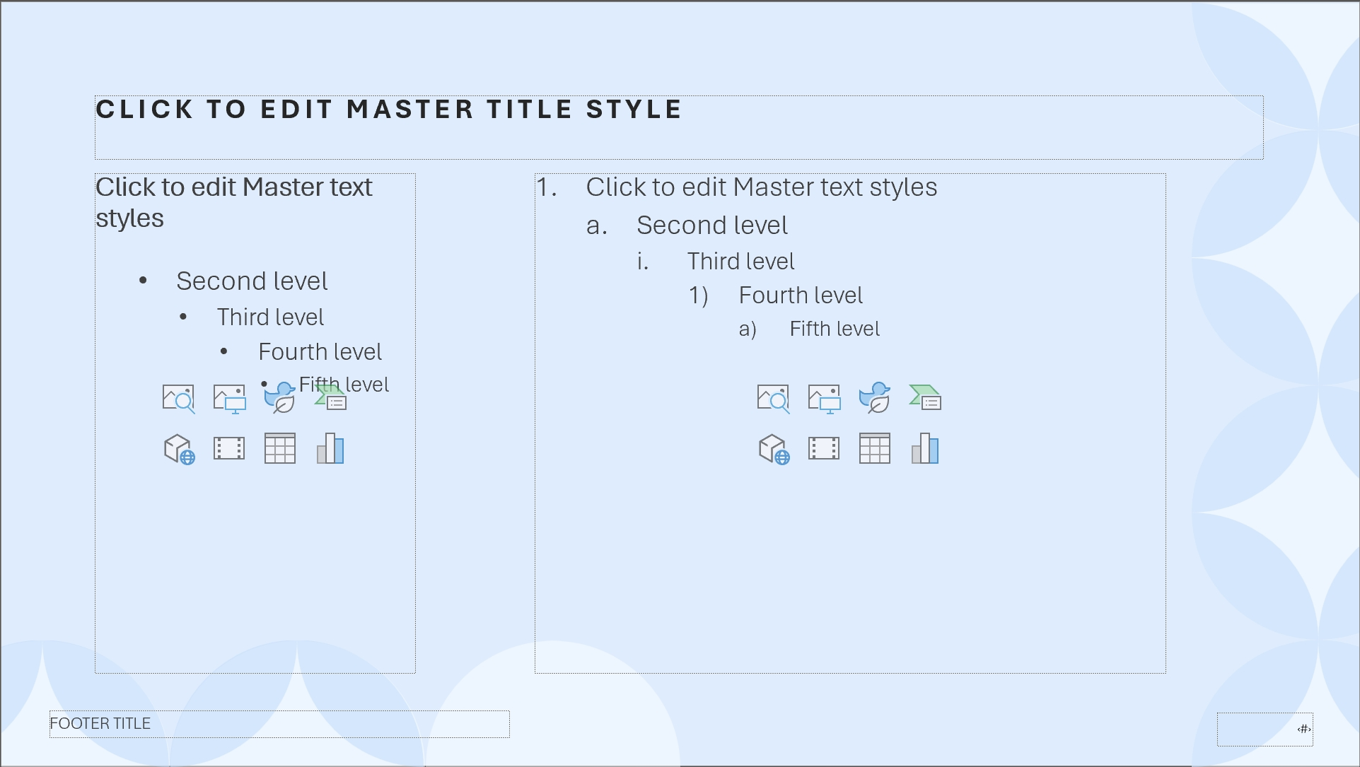
Better Collaboration with ChatGPT
Limited by chat interface when working on editing and revisions
Canvas offers a new interface for this kind of work

Slide 4
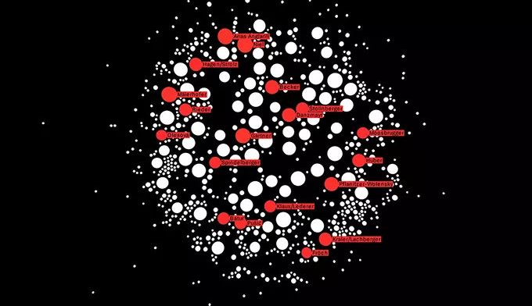
How Does Canvas Work?
You control the project, directly editing text or code
Menu of shortcuts to ask ChatGPT to adjust writing length, debug code, etc.
Can restore previous versions of your work using the back button in canvas

